Slide 1
Nested-Loop in C Programming
Md. Alamgir Hossain
Lecturer,
Dept. of CSE, Prime University
Mail: alamgir.cse14.just@gmail.com

Slide 2
Loops
Nested loop means a loop statement inside another loop statement. That is why nested loops are also called as “loop inside loop”.
Syntax:
for ( init; condition; increment ) {
for ( init; condition; increment ) {
statement(s);
}
statement(s);
}

Slide 3
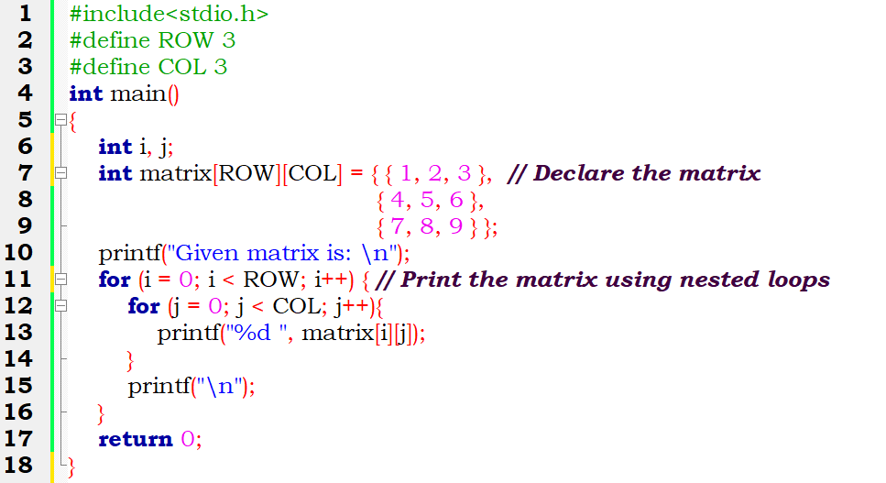
C program that uses nested for loop to print a 2D matrix

Slide 4
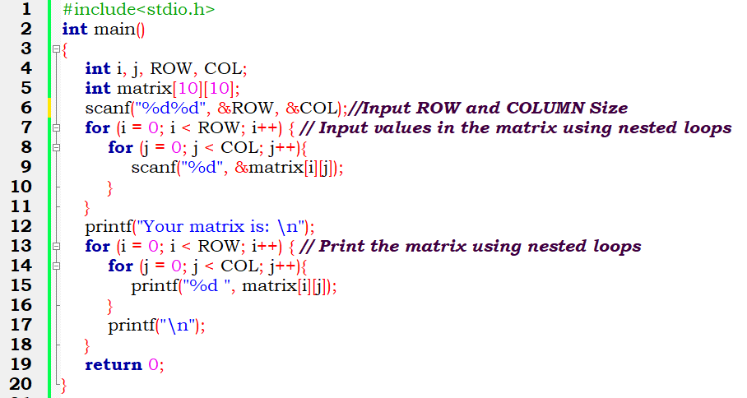
C program that uses nested for loop to input & print a 2D matrix

Slide 5
Thank You

